Slide 1

HUMAN FOLLOWing ROBOT USING ARDUINO
The oxford college of engineering
Dept, mca
By:
ASHIK E D [USN : 1OX21MC016]
SAFI MANNA [USN : 1OX21MC054
Under the guidance of : Dr. Puja Shashi
Associate Professor

Slide 2
Overview
Introduction
Objective and Aim
Hardware Requirements
Software Requirements
Block Diagram
Circuit Diagram
Applications
Challenges and Drawbacks
Future enhancement
Conclusion
References

Slide 3
introduction
In this high technology, a robot must be able to detect and follow the human. A robot that able to detect and follow is called human following robot.
The robot needs a mechanism which can make decision for it to take action accordingly so that the task can be performed correctly. The involved mechanism is sensor that can detect obstacles or object around the robot itself.
A robot that follows the human-like puppy. in this project you will learn a lot of things like the ultrasonic Arduino interface, working with the Arduino motor shield, and much more.
This Arduino robot having a sensor that can detect any object near it and can follow this object. if you come in front of the robot it will start following you. this robot consists ultrasonic sensor and IR sensor which help to follow the object. this is similar to the obstacle avoiding robot but it is opposite in the working.

Slide 4
Objective & AIM
To design a robot using Arduino that can detect a human target using sensors such as infrared or ultrasonic sensors.
To create a robot that can determine the direction and distance of the human target using sensor readings and use that information to follow the target.
To develop a user-friendly interface to control and program the robot.
To create a low-cost and accessible robot that can be used for educational purposes, as a hobby project, or in various industries, such as warehousing, security, or healthcare.
To improve the accuracy and precision of the robot's movements and ensure it can operate in a variety of environments and situations.

Slide 5
Hardware requirements
Ultrasonic Sensor
Servo Motor
Arduino Microcontroller
Motor Driver
Infrared Sensor (x2)
TT Gear Motor (x4)

Slide 6
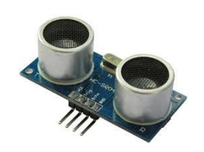
Ultrasonic sensor
The sensor consists of a transmitter that emits ultrasonic waves and a receiver that detects the reflected waves. When an object is in the path of the sound waves, some of the waves are reflected back to the sensor, and the time taken for the waves to return to the sensor is used to calculate the distance to the object.
Frequency is 44KHz
Speed of Sound waves is 340m/s
Distance can be calculated as Speed x Time / 2

Slide 7
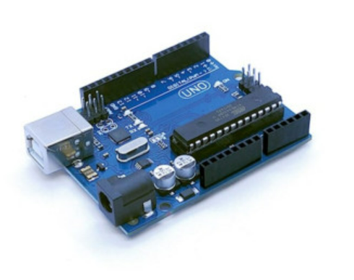
Arduino microcontroller
Arduino consists of both a physical programmable circuit board (often referred to as a microcontroller) and a piece of software, or IDE (Integrated Development Environment) that runs on your computer, used to write and upload computer code to the physical board
The Arduino Uno is a microcontroller board based on the ATmega328P microcontroller.
The Arduino Uno has 14 digital input/output pins, 6 analog input pins, and a 16 MHz quartz crystal oscillator.

Slide 8
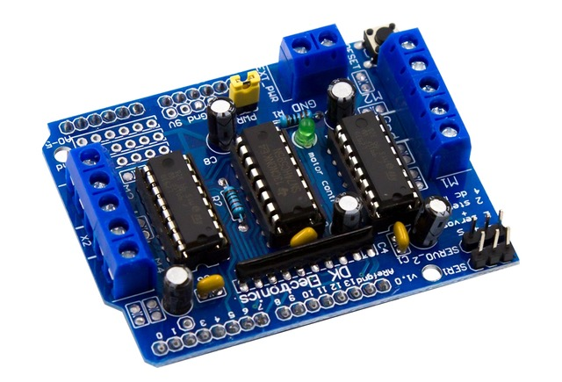
Motor Driver IC
This Motor Driver Board is designed to Work with L293D IC.
A motor driver IC (Integrated Circuit) is an electronic component that is designed to control the operation of motors. It is typically used in robotics, automation, and automotive applications to control the speed, direction, and position of DC, stepper, or servo motors.
This can control 4 DC Motors, their direction using control lines and their speed using PWM.

Slide 9
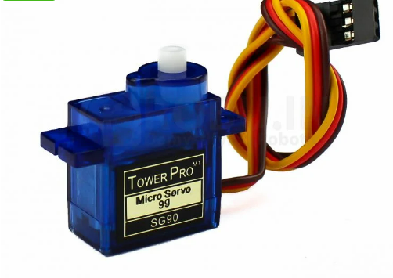
Servo motors
Servos are mainly used on angular or linear position and for specific velocity, and acceleration.
The motor provides the rotational power, while the gearbox reduces the rotational speed and increases the torque output. The control circuit receives signals from a microcontroller or other control system, and then adjusts the motor output to achieve the desired position or speed.
servo motors get their name from the fact that they can be relied upon to operate "exactly as commanded"

Slide 10
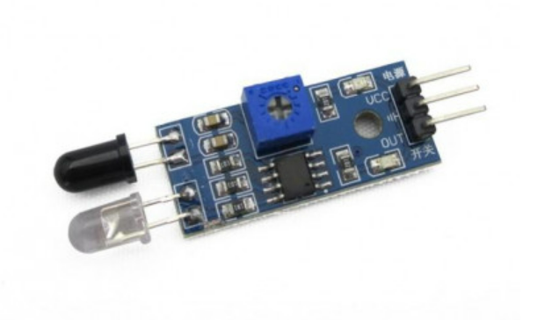
Infrared sensor
An infrared (IR) sensor is an electronic device that detects infrared radiation in its surroundings. Infrared radiation is a type of electromagnetic radiation that has a longer wavelength than visible light and is invisible to the human eye. Infrared sensors are commonly used in a variety of applications, including motion detection, temperature sensing, and remote control systems.
It is used in temperature sensing applications, where they can measure the temperature of a surface based on the amount of IR radiation it emits.

Slide 11
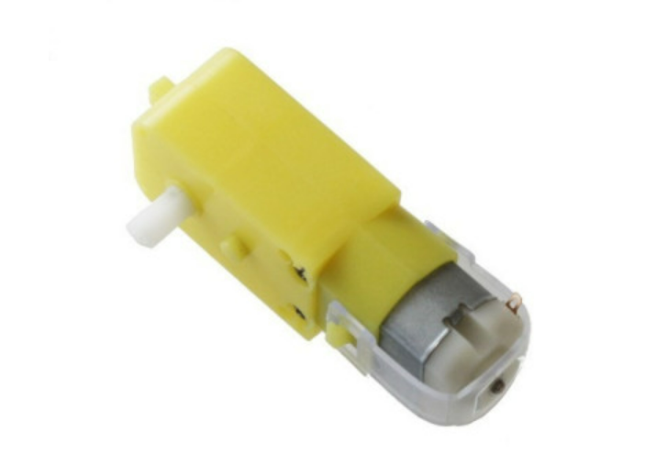
TT gear motor
TT gear motors are typically powered by a DC power source and can be controlled using a motor driver or other electronic control systems.
Savings On Expenses. Using a gear motor to increase torque and lower speed eliminates the expense of running the system
TT gear motor is a type of small electric motor that is commonly used in robotics
Converts direct current electrical power into mechanical power

Slide 12
Software requirements
Tool
Arduino IDE
The Arduino IDE (Integrated Development Environment) is a software application that is used to write, compile and upload code to Arduino microcontroller boards. The Arduino IDE is an open-source software that is available for free download on the official Arduino website.
The Arduino IDE provides a user-friendly interface that allows beginners to easily start programming microcontrollers. The IDE has a code editor that supports multiple programming languages including C and C++, which are commonly used for programming Arduino boards. The editor provides syntax highlighting, code suggestion, and error checking, which helps programmers to write clean and error-free code.

Slide 13
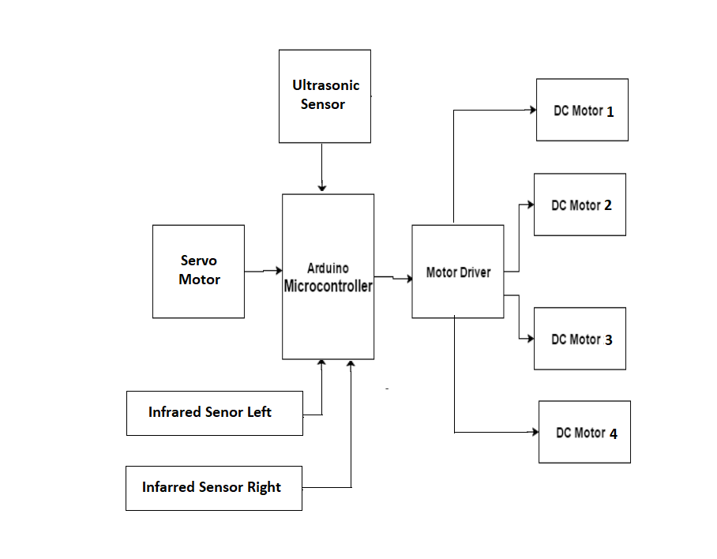
Block diagram

Slide 14
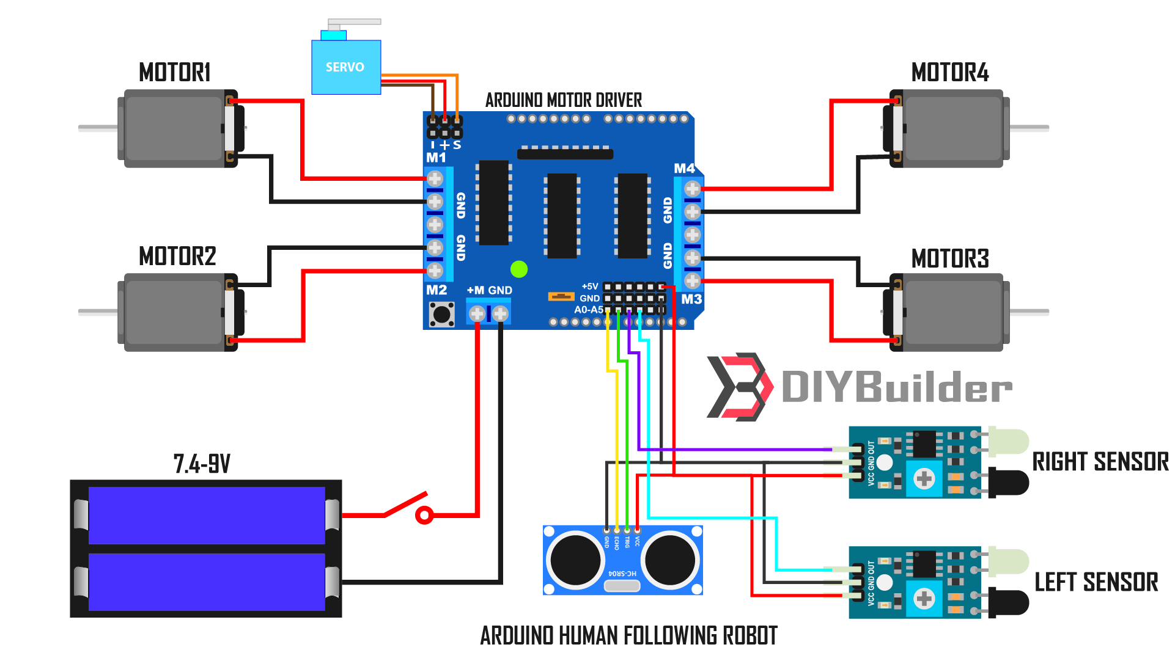
CIRCUIT DIAGRAM

Slide 15
APPLICATIONS
They can be used in industries as automated equipment carriers
Code compatibility and expandability across different Arduino boards
It can be used for home for floor cleaning
In hotels they are being used for the transfer of things from one place to another following a straight path.
Cost is less as Arduino is open source
The schematic of Arduino is open source. So for future enhancement of the project the board can be extended to add more hardware features

Slide 16
Challenges & Drawbacks
Limited range
Environmental factors
Power consumption
Limited payload capacity

Slide 17
Future Enhancement
Improve the robot’s sensing capabilities
Implement machine learning algorithms
Add speech recognition and natural language processing
Design a better mechanical structure

Slide 18
Conclusion
In conclusion, creating a human-following robot using Arduino is a challenging yet rewarding project. With the right components, software, and programming, it is possible to design a robot that can accurately detect and track human movement and follow them accordingly.
To create a functional human-following robot, one must consider the appropriate sensors to use, such as ultrasonic sensors, infrared sensors, or cameras, depending on the environment and application. The robot's motor control and power source must also be carefully chosen to ensure accurate movement and longevity.
The Arduino platform provides a versatile and accessible way to control the robot's behavior, with various libraries and functions available to simplify the programming process. By combining the hardware and software components, one can create a human-following robot that is both efficient and effective.

Slide 19
REFERENCE
K. Morioka, J-H. Lee, and H. Hashimoto, “Human-following mobile robot in a distributed intelligent sensor network”, IEEE Trans. Ind. Electron., vol 51, no. 1, pp. 229-237, Feb. 2004.
Y. Matsumoto and A. Zelinsky, “Real-time face tracking system for human-robot interaction”, in 1999 IEEE International conference on systems, Man, and Cybernetics, 1999. IEEE SMC ’99 Conference Proceedings, 1999, col. 2, pp. 830-835 vol 2.
N. Bellotto and H. Hu, “Multisensory integration for human-robot interaction”, IEEE J. Intel. Cybernetic. System., vol. 1, 2005.
H. Takemura, N. Zentaro, and H. Mizoguchi, “Development of vision-based person following module for mobile robots in/out door environment”, in 2009 IEEE International Conference on Robotics and Biometrics (ROBIO), 2009, pp.

Slide 20
THANK YOU

